Slide 1
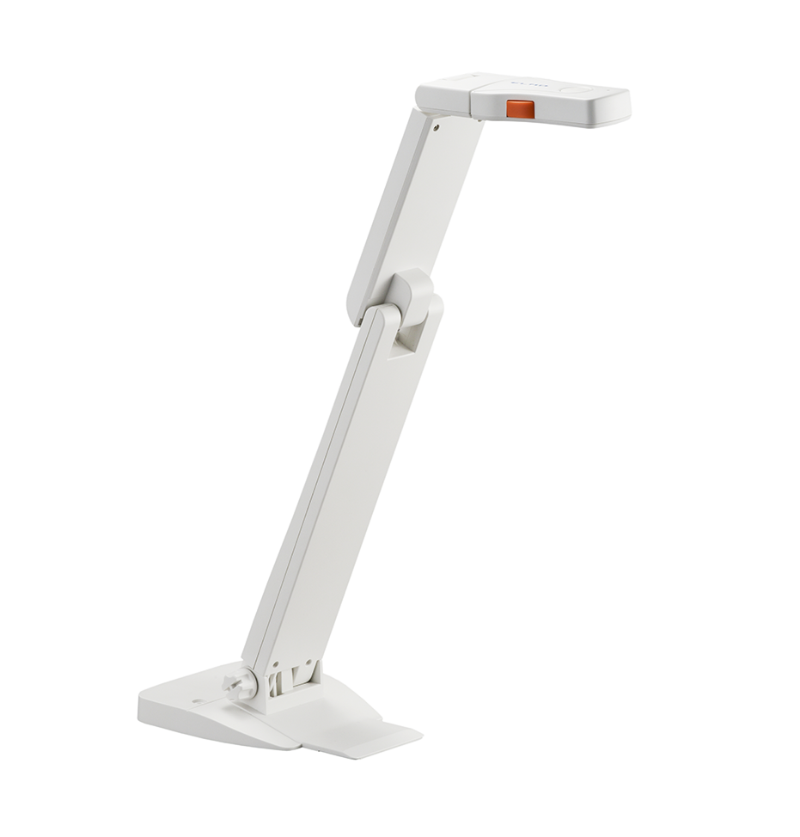
Using the Elmo OX-1 with Zoom Video Conferencing

Slide 2
Elmo OX-1
The manual for the Elmo OX-1 can be found here
The Elmo OX-1 attaches to your computer by a USB cable.
Your computer should automatically download the necessary drivers.

Slide 3
Imagemate+C software
We recommend the usage of the Imagemate+C
You can navigate to the Imagemate website here
Google Chrome browser is the ONLY supported browser for Imagemate+C
Here are the system requirements for Imagemate+C

Slide 4
Image Mate Functions
There are three functions in Imagemate.
You can use Whiteboards with something like a tablet for writing.
You can display content such pictures. It will not display PDFs or PowerPoint slides.
And you can use the document camera directly in the software.

Slide 5
Imagemate Basic Actions
Full Screen
Take a picture
Rotate Background
Select Input
Zoom Function
Record
Freeze screen
Mute/Unmute
Help

Slide 6
Using the Elmo OX-1 as a document camera in Imagemate
Use the “Rotate Background” button to orient your screen.
Remember to use the autofocus (orange button) on the document camera to make the image clear.
Within Imagemate you have the ability to take pictures of what you are writing or doing below the camera. They will be downloaded at the bottom of the Chrome browser. Allowing you to save important parts of your class with a click of an icon.
You can zoom in to an image.
While zoomed in you can the image about within Imagemate simply by clicking and dragging on the screen.

Slide 7
Using Imagemate with Zoom
While you have Imagemate open you will be able to see the Elmo OX-1 as a video source for Zoom, but it will not be usable.
When you click on the camera option, you may receive the following error message:
Instead, you should just navigate to the browser window for Imagemate in through “Share Screen.”
This saves a lot of time! You will not need to switch your video source. Simply switch between your applications on your computer since this will be all within “Share Screen.” You will never have to change your video source.

Slide 8
More on Imagemate and Zoom
Imagemate+C will not interfere with the use of the audio on the document camera for your use of Zoom.
You can continue to record your Zoom session.
If you are not using Imagemate while using Zoom at the same time, the functionality as a separate video input within Zoom will return.
If you have questions or problems using Imagemate with Zoom, please email us at gr-atc-ttl@wpi.edu.

